Slide 1
Big Data and rHadoop
Chunmei Zhu

Slide 2
Big data needs
Scenario 1: big data need for a person in insurance cost
How can an insurance company judge a person’s life expectancy by given DNA, medical records and lifestyle (smoking, drinking, etc.) ?
DNA – not only the person but also the related family recode in health system
Medical records – history from medical offices and consumer records from pharmacies
Lifestyle – item expense from the credit cards and elements in the blood data
Scenario 2: big data need for population in disease control
1918 Spanish flu killed millions people but not many in 2009. Because of advances in medicine – much better antibiotics? Yes, but when it goes into adv stages and medical field couldn’t help.
Disease Control – asked the doctors to report it when new cases of flu and by time the doctors could tabulate the results it took two weeks. – the flu had spread!
Scenario 3: big data need for algo trading in Finance
Investment banks already build algo trading systems using mathematical models by mathematics and statistics to speed up to booking trades. These algorithms read news and look for a combination to match a particular item then the computer can decide to sell or buy at a particular time.
Now there are billion shares trading every day and two- third are done by computer algorithms. The system show us the spike and trades within seconds. For example, FXALL, HSBC trading platform, refreshes all data in every 5-6 seconds.
Challenges in technology
Data storage
High Speed Computing
Cost affordability

Slide 3
Solution for big data
To solve problem from big data in data storage, computing speed, companies build super machines and improved data architecture models.
Client
Client
Client
Client
Client
…..
Central Contact Point
Servers
Servers
Servers
……
GFS – Google File System
Indexing the web
Standard hardware
Reliability through redundancy and replication – 3 times copies
MapReduction by cluster nodes
Super Server
Client
Client
……
Client
Client
Client
Next generation
Next generation
Problems: unhappy clients, overload servers, expensive
Notes:
First model, all data storage and process were relied on one super server. Replacement or improvement of the machine is very expensive. It isn’t satisfy the overwhelm number of clients.
Second model, the idea was from scientific computing space. To break down the tasks to smaller servers and process more requests from clients, control contact pint like a storage area network or a distributed file system. It determine which server you want to talk then connects to the back-end machine. The cost is upgrading back-end machines and rental of a place to store these servers. It’s costly.
GFS model was created by google with a new computing model, MapReduce.

Slide 4
Hadoop
Hadoop is used to deal with high volumes of data and high velocity and variety of data.
Velocity – huge amount of data being fed in continuously
Hadoop cluster – store like 25 petabytes of data in 4500 machines
The idea of Hadoop software implement is from Google.
Google File System -> Apache HDFS (Hadoop distributed file system), which is a data storage like data files and directories which can be any type of data
MapReduce -> Apache MapReduce, which is Hadoop cluster for data processing to manage the jobs
Big Table -> Apache HBase, which is a Hadoop data base used to read and write data in real time and store info to HDFS.
Data flow in MapReduce:
Read data
Map (like “select” in SQL)
Partition the output
Shuffle and Sort Keys (like “where” )
Reduce: (like Group by, count)
Write the results
Page Rank
Source: https://www.youtube.com/watch?v=vnM0Xilq4Gw
Notes:
To search a particular data, you need to program a process for the data in HDFS file system, that is called the MapReduce. You write a query in MapReduce.
The data flow in MapReduce is:
Read data
Map: extract something you care about in the each record
Partition the output which keys go to which reducer
Shuffle and Sort Keys (like “where” in SQL)
Reduce: aggregate, summarize and filter (like Group by, count)
Write the results
Page Rank: search all pages on the web and aggregate the links and find how many links point to one page/site.

Slide 5
Hadoop MapReduce – Card process
Input
Reducing
Output
Splitting randomly
Mapping
Shuffling
Spade A, 1
Spade 8, 1
Red Heart 4, 1
Clue 2,1
Spade 9,1
……
13 Cards
Spade, (1,1,1,…)
Spade, 13
52 Cards
(read in as string)
Diamond 2, 1
Clue J, 1
Red Heart 8, 1
Clue 5,1
Clue Queen,1
……
Spade, 13
Heart, 13
Diamond, 13
Clue, 13
13 Cards
Heart, (1,1,1,…)
Heart, 13
13 Cards
……
Diamond, (1,1,1,…)
Diamond, 13
13 Cards
Clue, (1,1,1,…)
Clue, 13
Heart 2, 1
Heart J, 1
Spade k, 1
Diamond 10,1
Clue 6,1
……
List (type, #)
String ()
Type, List(1,1,…)
Type, List(#)
List (type, #)

Slide 6
Cord Hadoop architecture - Master Slave Topology
Name Node
Core switch
(Task Tracker)
……
Core switch
(Task Tracker)
Core switch
(Task Tracker)
Master Machine: Hadoop Cluster
(MapReduce: Job Tracker)
Cluster : Master
HEFS : Master
MapReduce
(Slave)
Data Node
Data Node
Data Node
HEFS : Slave
Rack Switch #1
Computer 1
Computer 2
……
Rack Switch #2
Computer 1
Computer 2
……
Rack Switch #n
Computer 1
Computer 2
……
Slave Machines: distributed over cluster
If a machine spends 45 mins to finish a task, breaking the take to 10 machines and just is done in 4.5 mins
Notes:
Hadoop cluster: Multiple machines with Hadoop. As you need more storage or computer power, you add another machine.
Job Tracker: MapReduce coordinator which accepts user jobs and divides it into tasks and assigning it to task trackers.
Task Tracker runs the tasks and reports the status back to the job tracker, which are responsible for noticing if a task tracker disappears – hardware or software failure, and reassign that task to another task tracker.
(Source from https://www.youtube.com/watch?v=vnM0Xilq4Gw)
For example, loading twitter data, and we have a large Hadoop cluster of 1000 servers. My twitter data might be replicated across 60 of them along with all the other profiles of twitter users. Hadoop keeps track of where all the copies of my profile are by Name Node. This seems like a waste of space, but it’s actually the secret sauce to the massive scalability magic in Hadoop.

Slide 7
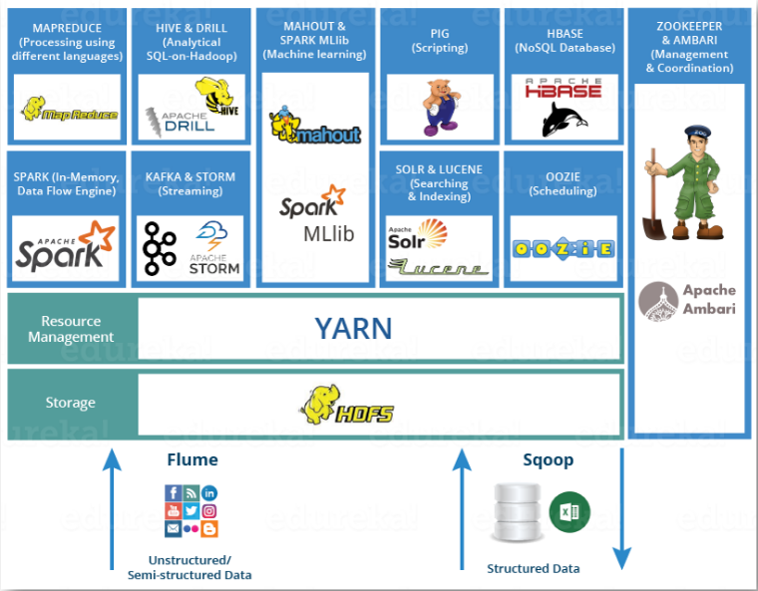
Hadoop Ecosystem
Source: https://www.edureka.co/blog/hadoop-tutorial/
Notes:
Hadoop is neither a programming language nor a service, it is a platform or framework which solves Big Data problems. You can consider it as a suite which encompasses a number of services for ingesting, storing and analyzing huge data sets along with tools for configuration management.

Slide 8
Hadoop (NoSQL) vs Traditional SQL
Data Transfer
Tradition SQL using schema on Write : before data transfer, we have to know the data structure and data types of DB1 must match the expecting of DB2. Otherwise, DB2 will sit errors and reject the data tram DB1.
Hadoop using schema on Read: when we write data into HDFS, we just bring it in without dictating any gatekeeping rules. So Hadoop read and store data then apply rules to the code instead of preconfiguring the structure of the data ahead of time.
Data Storage
In tradition SQL, the data is stored in a logical form with interrelated tables and defined columns.
In Hadoop, the data is a compressed file of either text or any other data types – NoSQL. The data is replicated across multiple nodes in the HDFS.
Waiting Time of Query data
Longer waiting time: Tradition SQL is implemented by 2 phase commit methodology, which means while it query data and hold until complete consistency across all the nodes before it release anything to the user.
Shorter waiting time: Hadoop is implemented by the eventual consistency methodology which is a far more realistic method of reading continuously updating feeds of unstructured data across numbers of servers so it provides immediately answer and eventually it would have a consistent answer.
Cons: the limit is now how creative we can get with that program. This Java based query also increases the complexity of talking to Hadoop.
Notes:
However, with Hadoop we have a caveat. Because the query is literally a mapping and answer consolidation program which propagates to a flexible number of servers, the sky is the limit on how creative we can get with that program. This Java based query also increases the complexity of talking to Hadoop. For this reason, you’ll find a lot of package distributions of Hadoop that provide some structure and focus to the Hadoop world.
For example, Facebook created something called Hive that allowed their team members that didn’t know how to write Java code to write queries in standard SQL. Hadoop is so flexible that Facebook was able to build a program to essentially mimic SQL behavior on demand. Some of the leading tools for data management and analysis are now beginning to natively write Map Reduce programs and pre-packaged schemas on read so that organizations dodn’t have to hire expensive data scientists to get value from this powerful architecture.

Slide 9
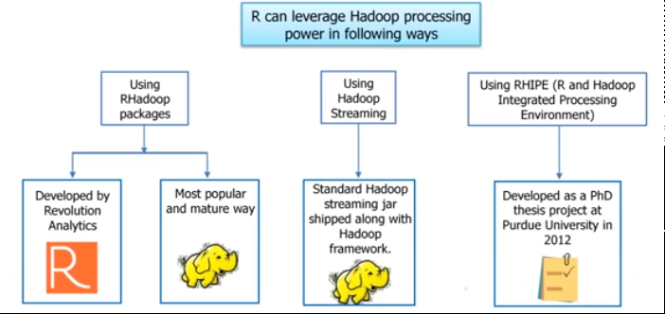
Leverage Hadoop with R (RHadoop)
Main packages in Rhadoop:
rmr: interface for running map/reduce jobs via hadoop streaming in r
rhbase: inteface to read/write data to/from hbase tables
rhdfs: provides file manipulation capabilities for HDFS
access hdfs from R
read from hdfs to R dataframe
write from R dataframe to HDFS
Source: https://www.youtube.com/watch?v=cSpwf9cj2aY&t=2014s

Slide 10
Thank you

